Slide 1
NLP for RE
Introduction of RE and NLP
Mariana Bento, PhD and Gouri Deshpande, PhD
Electrical and Software Engineering; Biomedical Engineering

Slide 2
Course Outline
A. Introduction of RE and NLP (not interactive) (25 mins)
B. Data gathering (interactive)(1hr)
C. Pre-processing using NLP operations for a dataset from Bugzilla (interactive) (1hr)
D. Modeling and evaluation (interactive) (30 mins)

Slide 3


Intros
Add name pic
y
Gouri Deshpande
Assistant Professor,
University of Calgary
E-mail: Gouri.deshpande@ucalgary.ca
Website: https://pages.cpsc.ucalgary.ca/~gouri.deshpande/
LinkdIn:https://www.linkedin.com/in/deshpandegouri/
Mariana Bento
Assistant Professor,​
University of Calgary​
E-mail: mariana.pinheirobent@ucalgary.ca​
Website: https://profiles.ucalgary.ca/mariana-bento
LinkdIn: https://www.linkedin.com/in/mariana-bento-b7a75010b/

Slide 4
Learning Goals
Introduction to RE
Introduction to NLP
Notes:
RE public repositories for data mining

Slide 5
Introduction of RE

Slide 6
The beginning is the most important part of the work
-Plato, 4 B.C
Requirements Engineering is an early lifecycle process that precedes analysis, design, coding and testing [1]
[1] Bencomo, Nelly, Jin LC Guo, Rachel Harrison, Hans-Martin Heyn, and Tim Menzies. "The Secret to Better AI and Better Software (Is Requirements Engineering)." IEEE Software 39, no. 1 (2021): 105-110.

Slide 7
Brief Introduction to Software Development Process
Inception
A simplified Linear model of software development process:
Knowledge Elicitation
Requirements Analysis
Design
Implementation
Testing

Slide 8
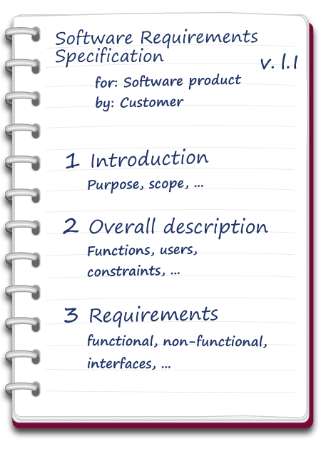
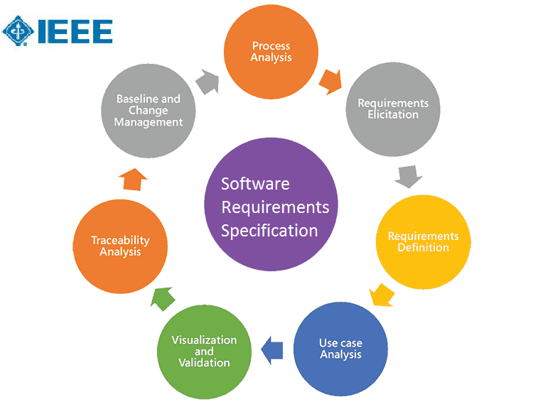
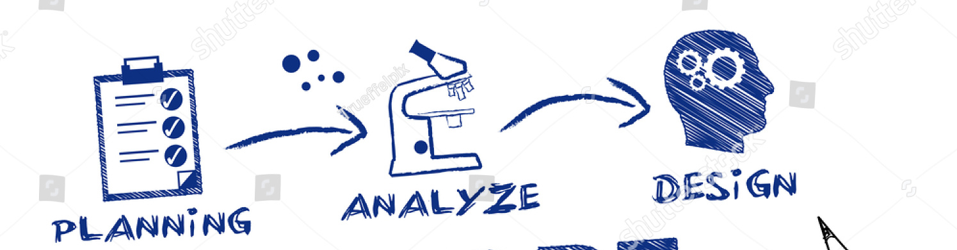
RE

Slide 9
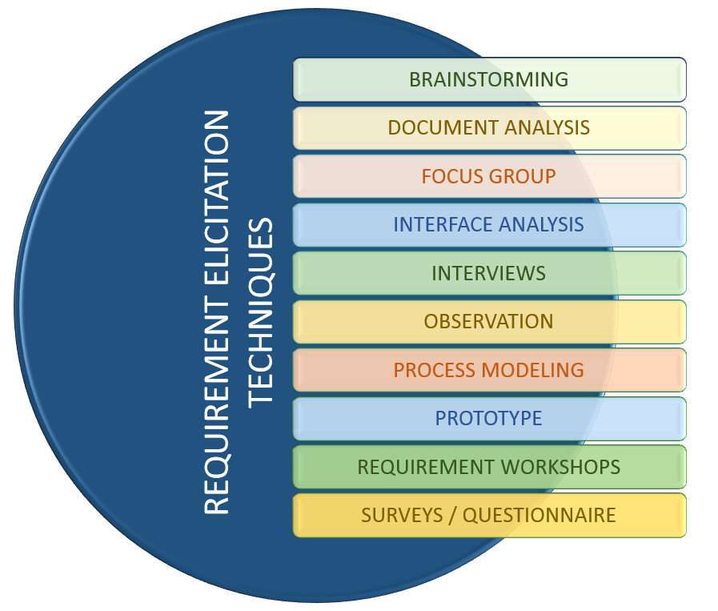
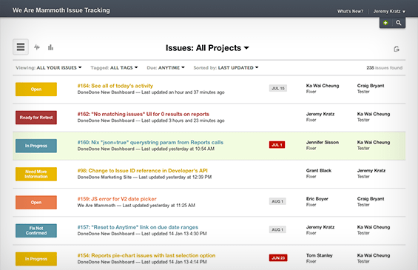


https://systemsplusgroup.blogspot.com/2017/02/requirement-elicitation-techniques.html
Notes:
Requirements elicitation is an excellent example of how things can improve with additional data, in this case in particular with textual data.

Slide 10
Introduction to NLP

Slide 11
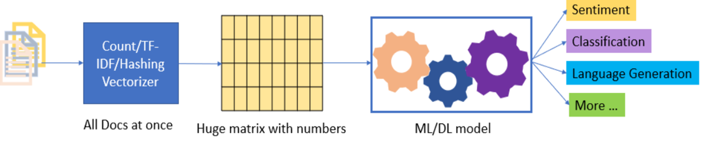
NLP and Machine learning
Source: https://www.datajango.com/deep-learning-and-nlp/

Slide 12
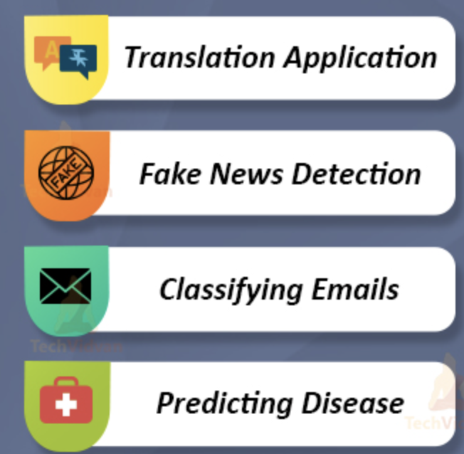
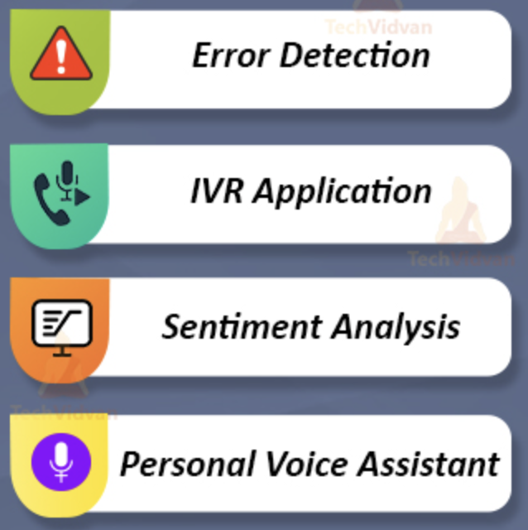
Natural Language Processing (NLP)
- NLP is a subfield of artificial intelligence that deals with the link between computers and human language.
- NLP involves programming computers to process and analyze a massive amount of natural language data.
Interactive Voice Response (IVR)
Curtsy: https://techvidvan.com/tutorials/natural-language-processing-nlp/

Slide 13
What Industry Application of NLP?
Search engines
Advanced text editors: Such as Grammarly.com
Computational advertising
Fraud detection
Sentiment analysis
Opinion mining
Text summarization
Context analysis

Slide 14
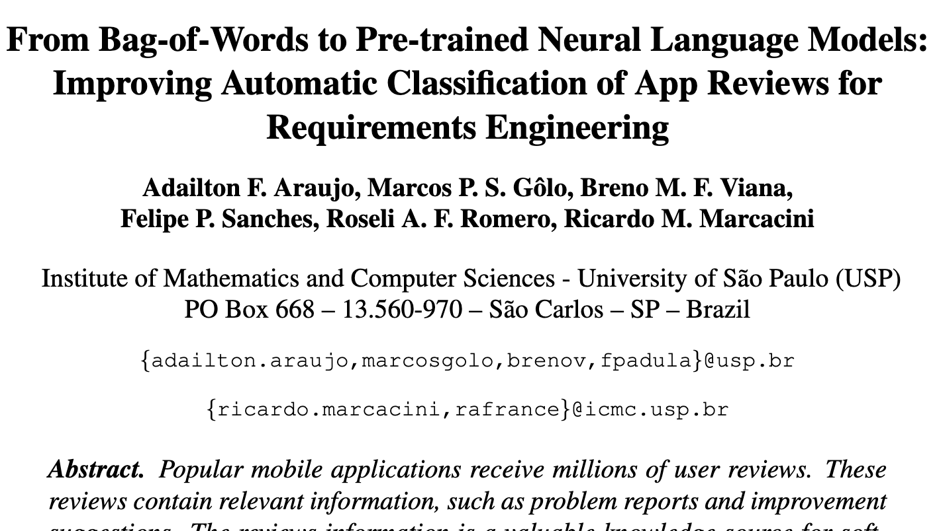
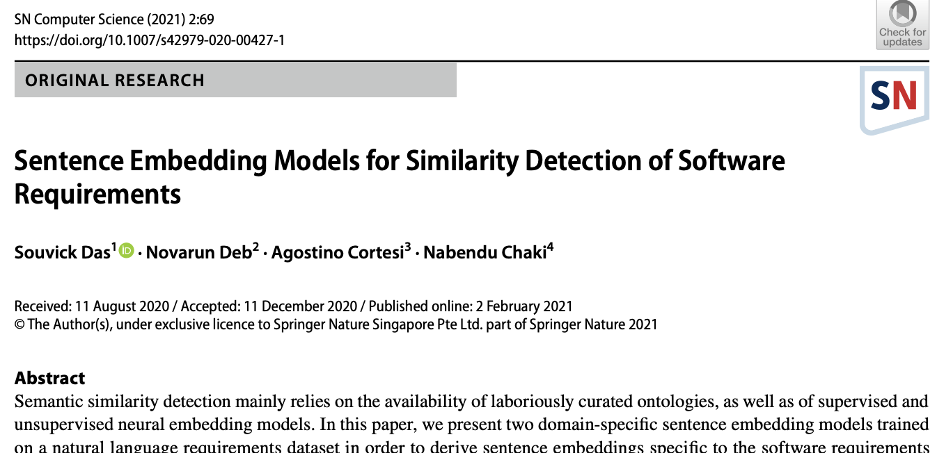
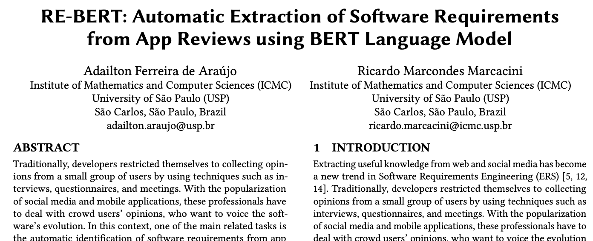
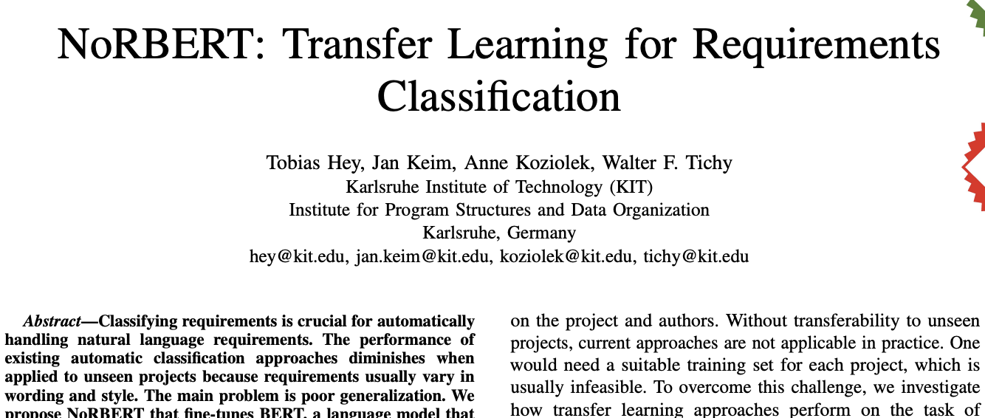
Applications NLP (and ML) in RE: Examples
14

Slide 15
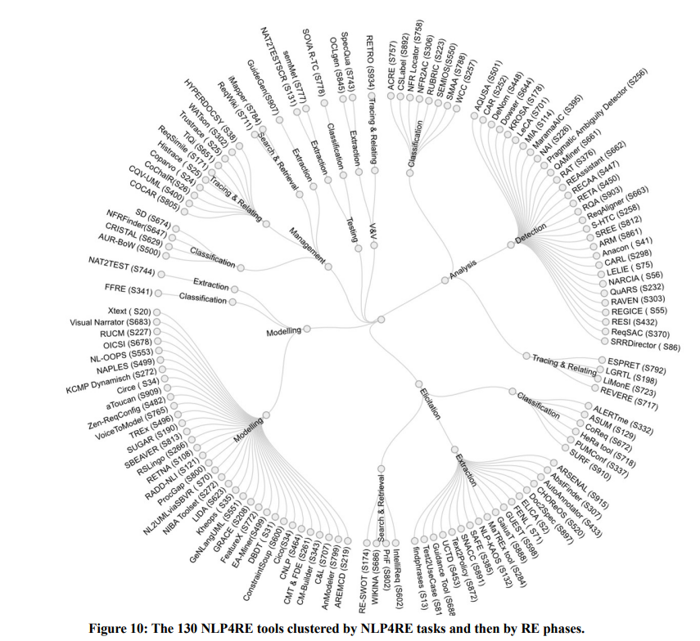
NLP for RE Tools
Zhao, Liping, et al. "Natural language processing (NLP) for requirements engineering: A systematic mapping study." arXiv preprint arXiv:2004.01099 (2020).

Slide 16
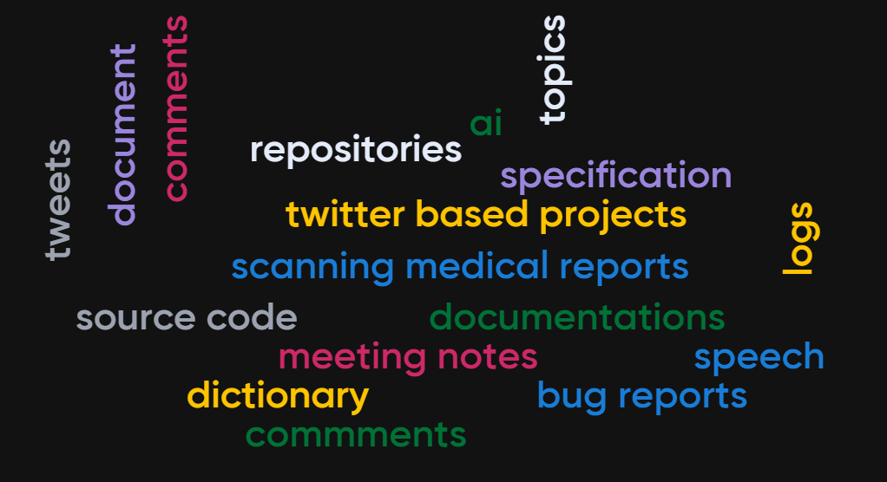
Software Projects are Textual in Nature

Slide 17
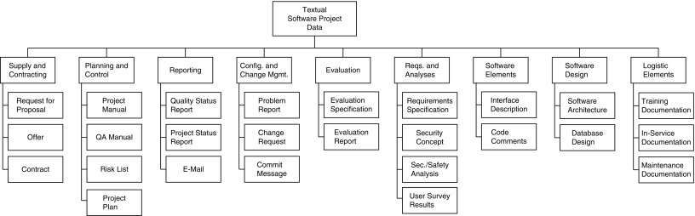
Textual Data in Software Projects
Customer review comments
Bird, Christian, Tim Menzies, and Thomas Zimmermann, eds. The art and science of analyzing software data. Elsevier, 2015.
17

Slide 18
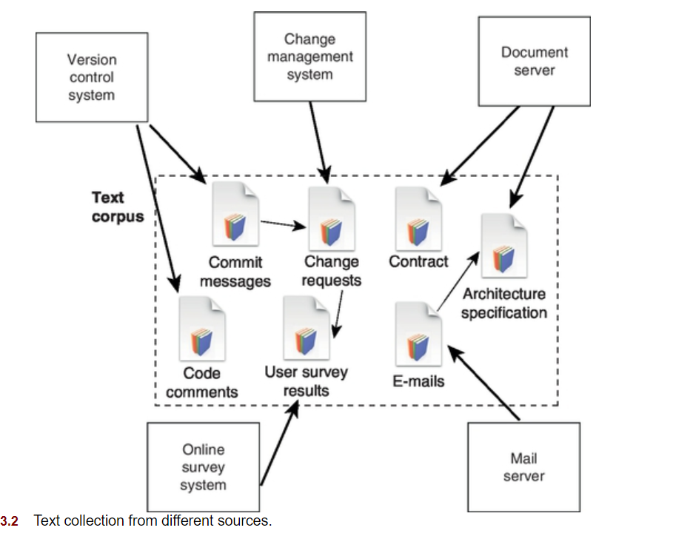





Textual Software Project Data and Retrieval
Custom extraction tool
API’s
Formatted files
Anonymize
Web crawling
Arnaoudova, Venera, et al. "The use of text retrieval and natural language processing in software engineering." Proceedings of the 37th International Conference on Software Engineering-Volume 2. 2015.

Slide 19
Importance of NLP in Software Engineering
Text Retrieval (TR) and NLP in software is one of the fastest growing areas of research in SE. [2]
Exposing the SE community to these techniques and their applications in SE would help to fill a gap in their current background and allow them to immediately use TR and NLP to advance their research.
In particular, for TR, approaches such as Vector Space Model, Latent Semantic Analysis, Latent Dirichlet Association, Language Models will be covered. NLP techniques covered will include part-of-speech tagging, stemming, stopwords elimination, semantics analysis, sentiment analysis, etc.

Slide 20
References
Bird, Christian, Tim Menzies, and Thomas Zimmermann, eds. The art and science of analyzing software data. Elsevier, 2015.
Arnaoudova, Venera, et al. "The use of text retrieval and natural language processing in software engineering." Proceedings of the 37th International Conference on Software Engineering-Volume 2. 2015.
Juergens, Elmar, et al. "Do code clones matter?." 2009 IEEE 31st International Conference on Software Engineering. IEEE, 2009.
Juergens, Elmar, et al. "Can clone detection support quality assessments of requirements specifications?." Proceedings of the 32nd ACM/IEEE International Conference on Software Engineering-Volume 2. ACM, 2010.
https://medium.com/square-corner-blog/topic-modeling-optimizing-for-human-interpretability-48a81f6ce0ed
Stevens, Keith, Kegelmeyer, Philip, Andrzejewski, David, and Buttler, David. Exploring topic coherence over many models and many topics. In EMNLP, 2012.

Slide 21
SURVEY (strongly disagree; disagree; neutral; agree; strongly agree)
1) The presentation delivered relevant information
2) The material covered was sufficient for the presentation duration?
3) I learned new things
4) The presenters seemed well organized
5) What did you learn from this presentation? (400 characters)

Slide 23
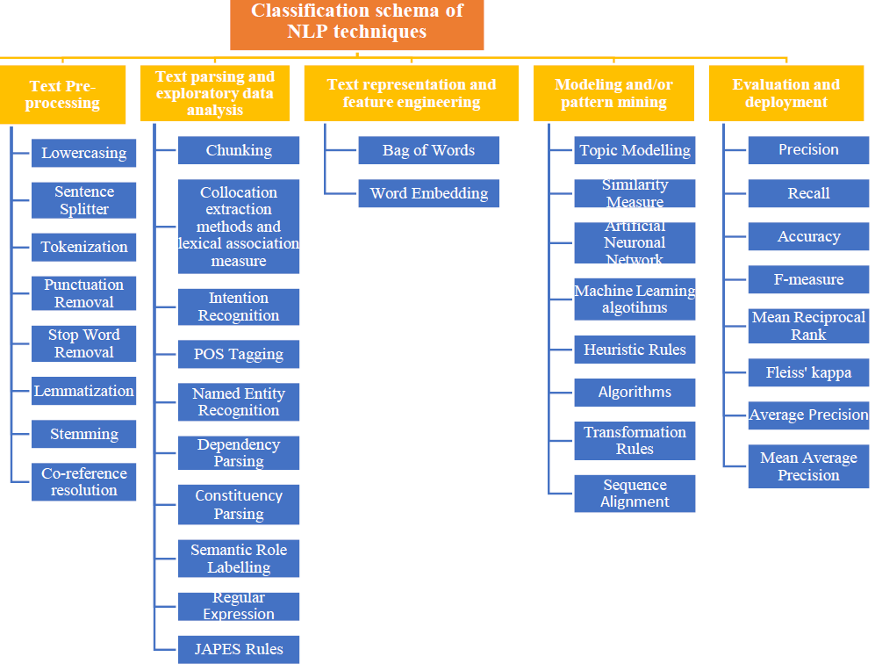
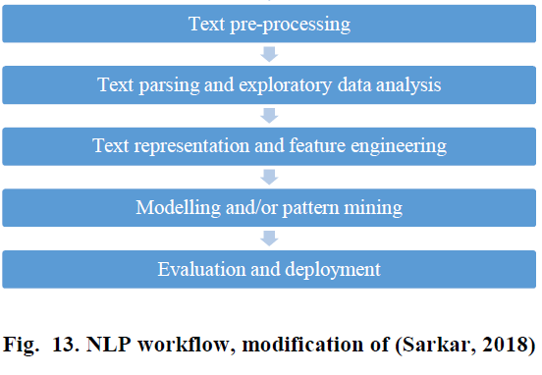
1
Introduction
2
NLP and ML for RE
3
NLP based RE tools
4
State-of-the-art
5
NLP schema
22
Moises Gonzalez-Garcia, Speech recognition, NLP, and the use of ontologies to identify the problem-domain and solution requirements: A systematic mapping study, Information and Software Technology, 2019, In press

Slide 24
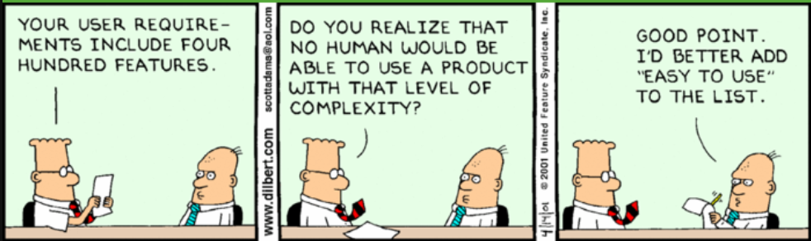
Dilbert on number of requirements
Dilbert (who is the main character here) comic is known for its satirical office humor
23

Slide 25
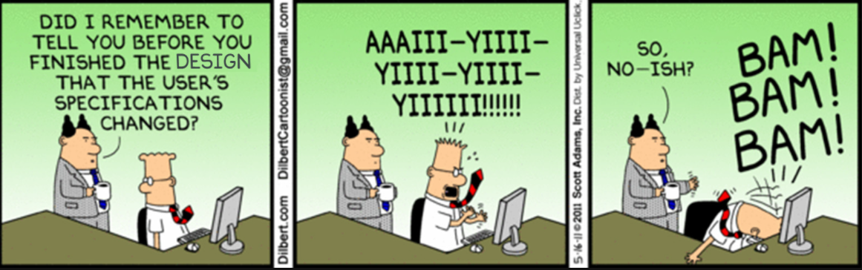
Dilbert on changing requirements
3
NLP based RE tools

